Slide 1
Hotel Booking Demand in Portugal:
When is The Best Time?
Kyle Reedy

Slide 2

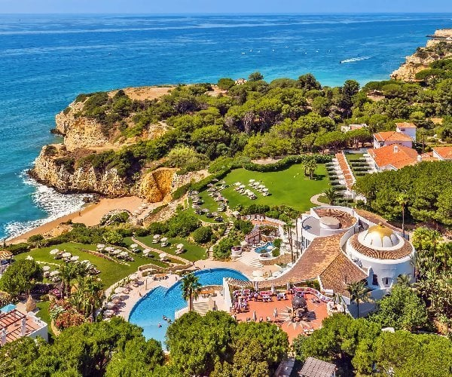
Overview
Hotel bookings between two hotels in southern Portugal
-Hotel 1 at the resort region of Algarve
Dataset Reference: https://www.kaggle.com/datasets/jessemostipak/hotel-booking-demand?resource=download
-Hotel 2 in the capital city of Lisbon

Slide 3
When is the best time of the year to reserve?
The Questions:
Days of Stay
Average Price Per Month
Average Arrival Per Month

Slide 4
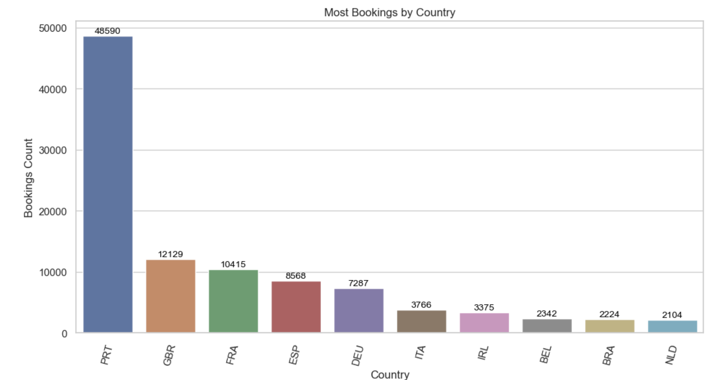
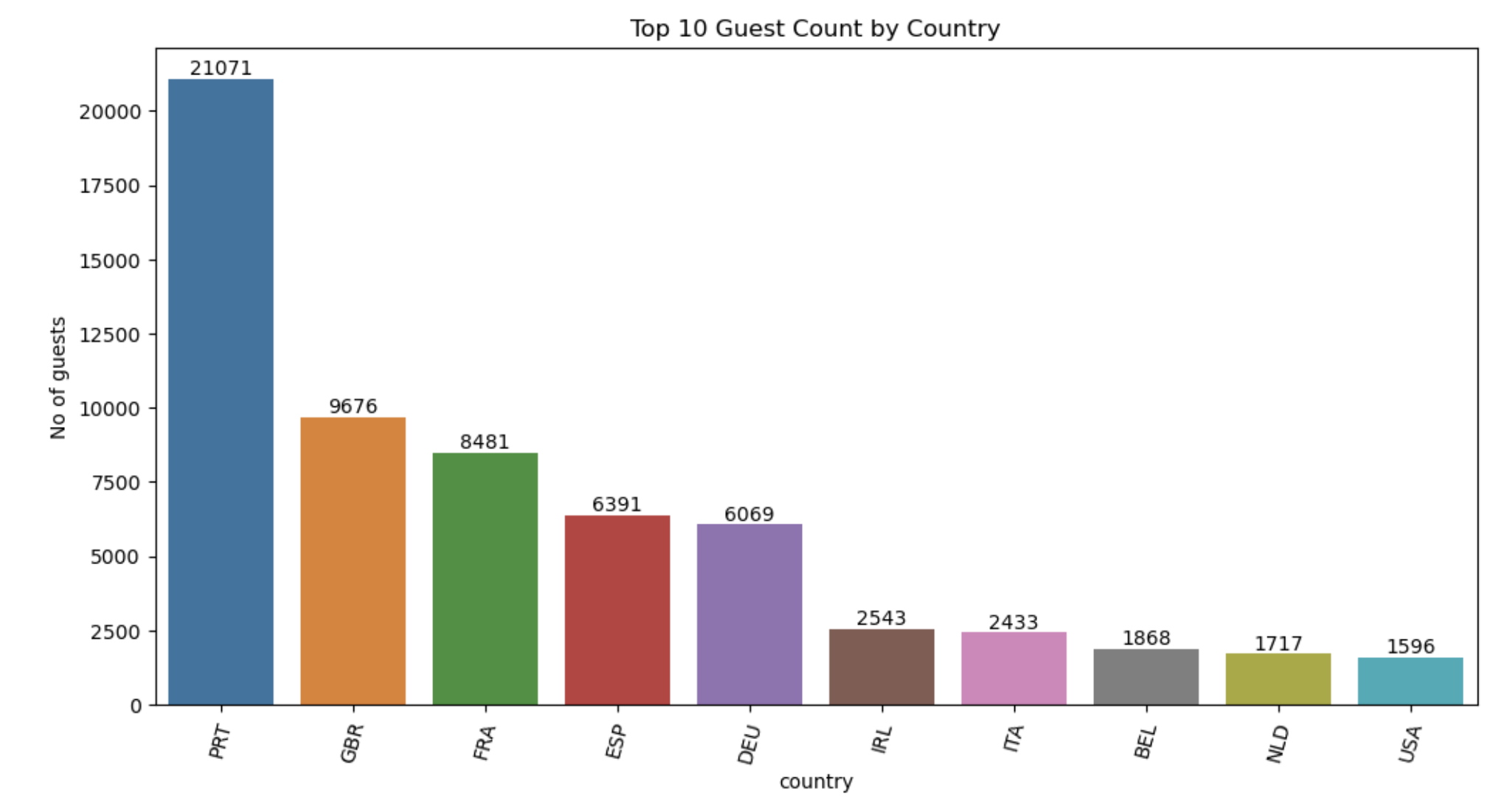
Understanding the Cumulative Data
N0. 1 Portugal - High Bookings and Guest Arrival Count

Slide 5
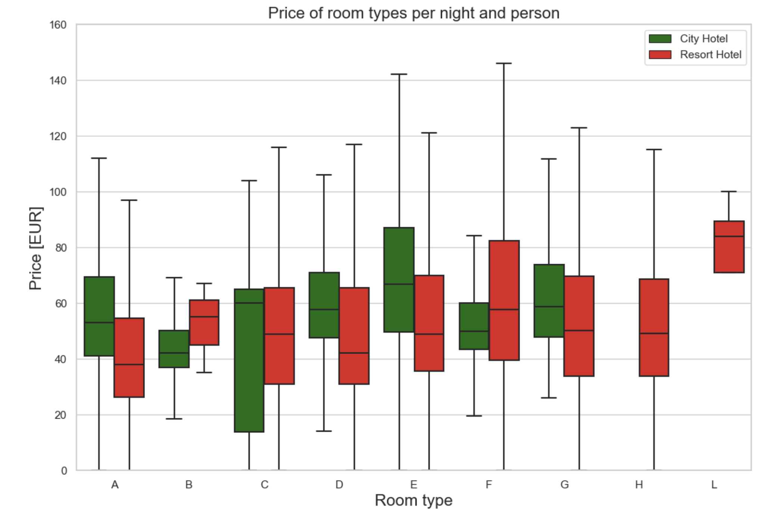
Price Analysis
Item 1
Item 2
Findings
From non-cancelled bookings:
Resort Hotel -> 47.49 € per night and person.
City Hotel -> 59.23 € per night and person.
39
4
29
27
4
5
20
35
5
25
22
15
20XX
20XX
20XX
20XX

Slide 6
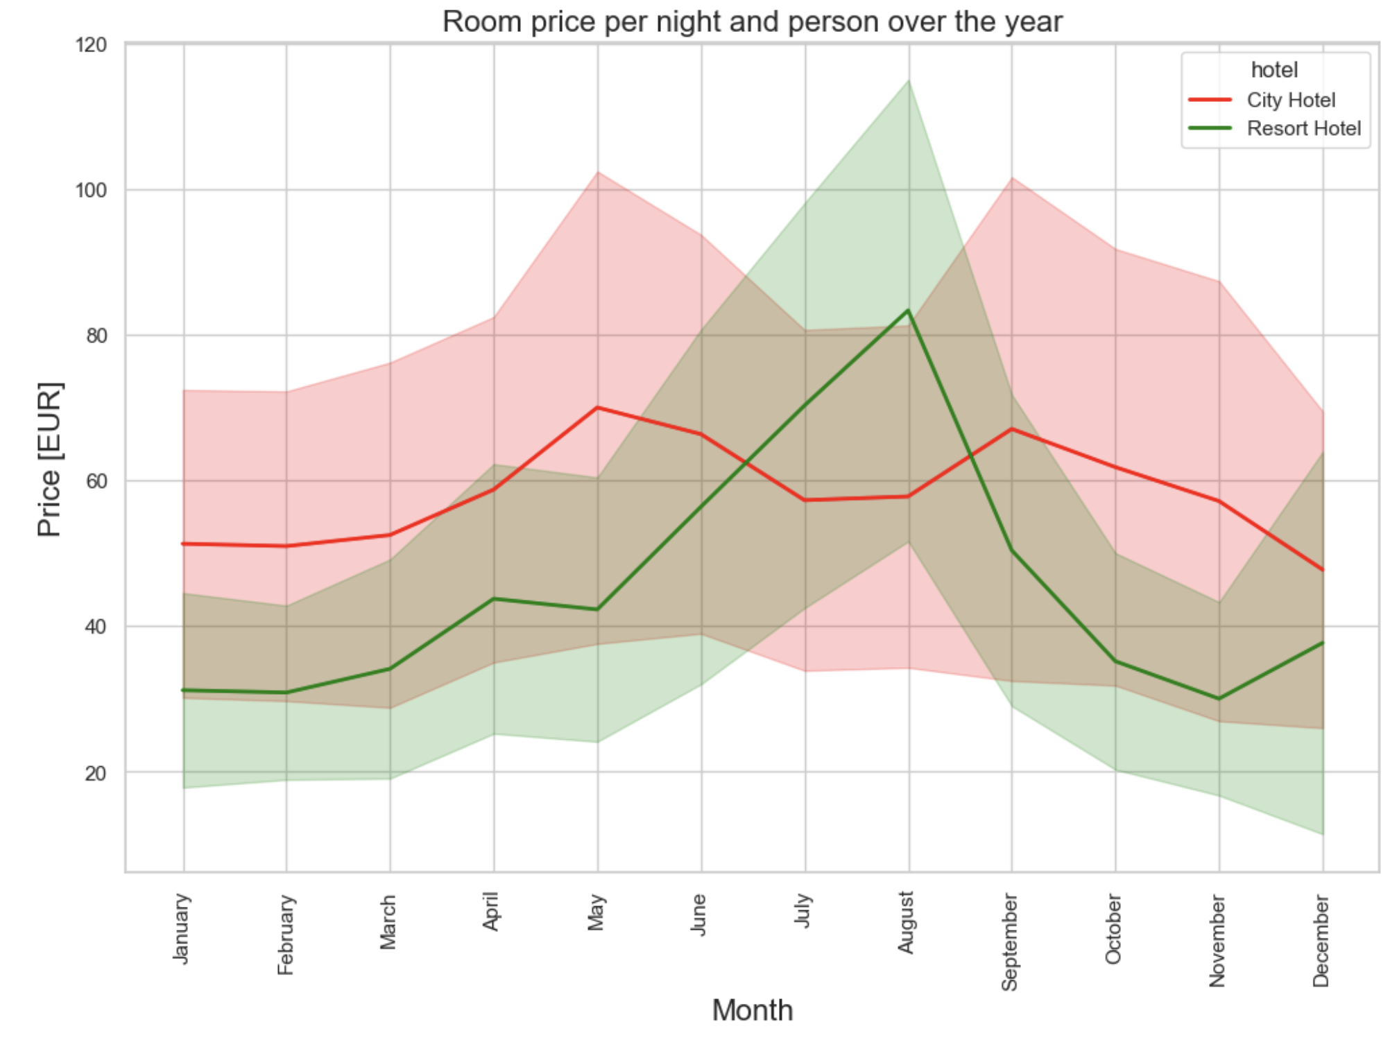
Price Change Over the Year
Peak
Peak
Peak
Lowest
Lowest

Slide 7
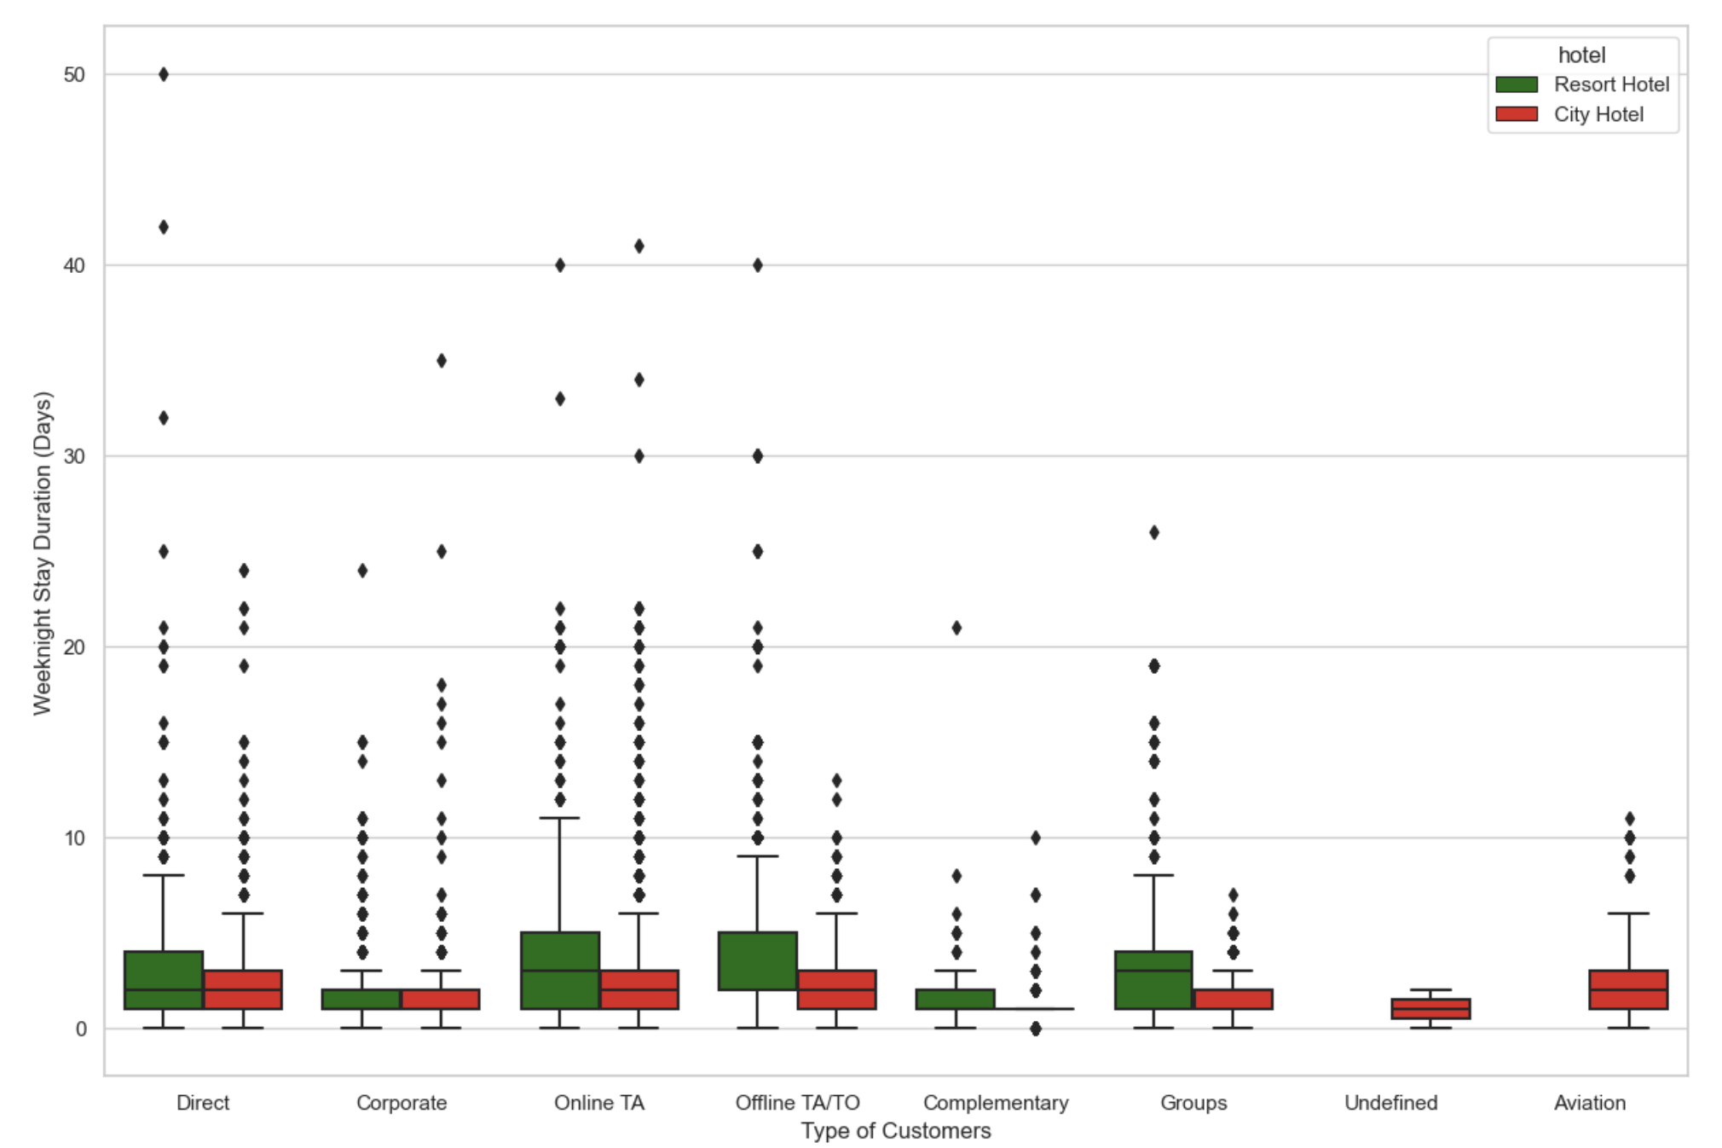
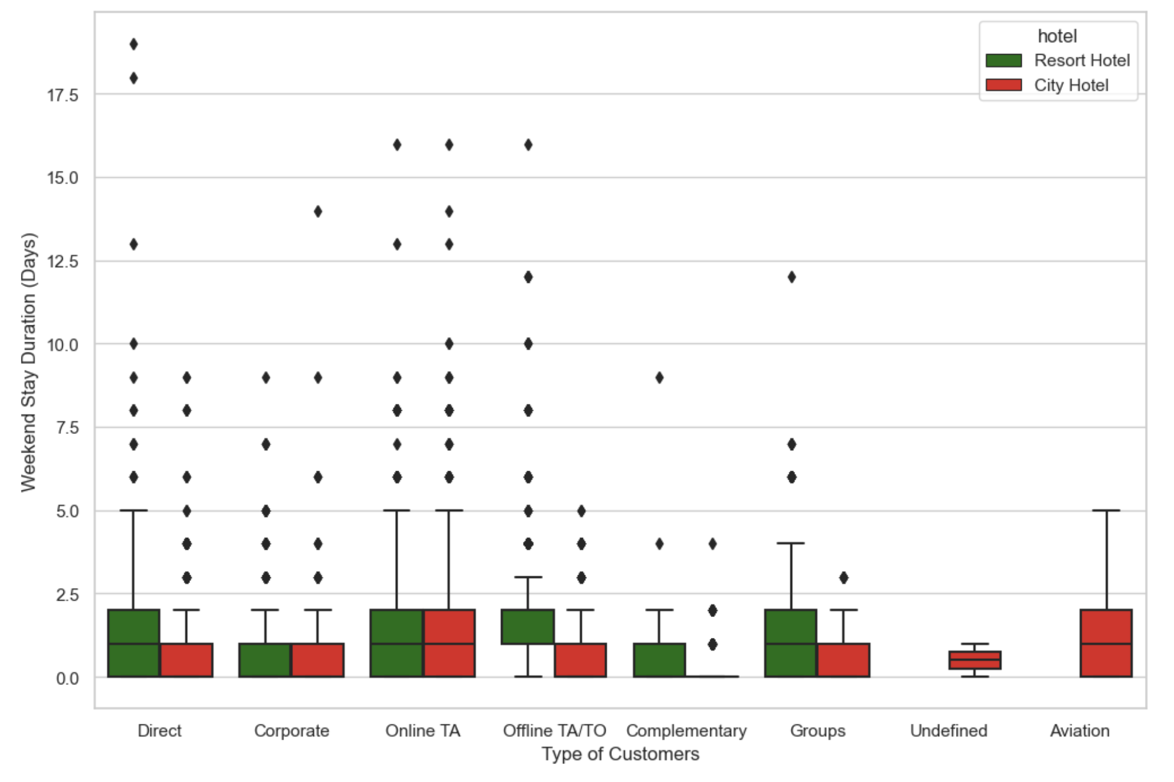
Stay Duration - Weekday vs Weekend
Weekday
Weekend
Most customers prefer not to stay in a city hotel for more than 1 week, although it is more common for customers to stay in a resort for 12-13 days on average.

Slide 8
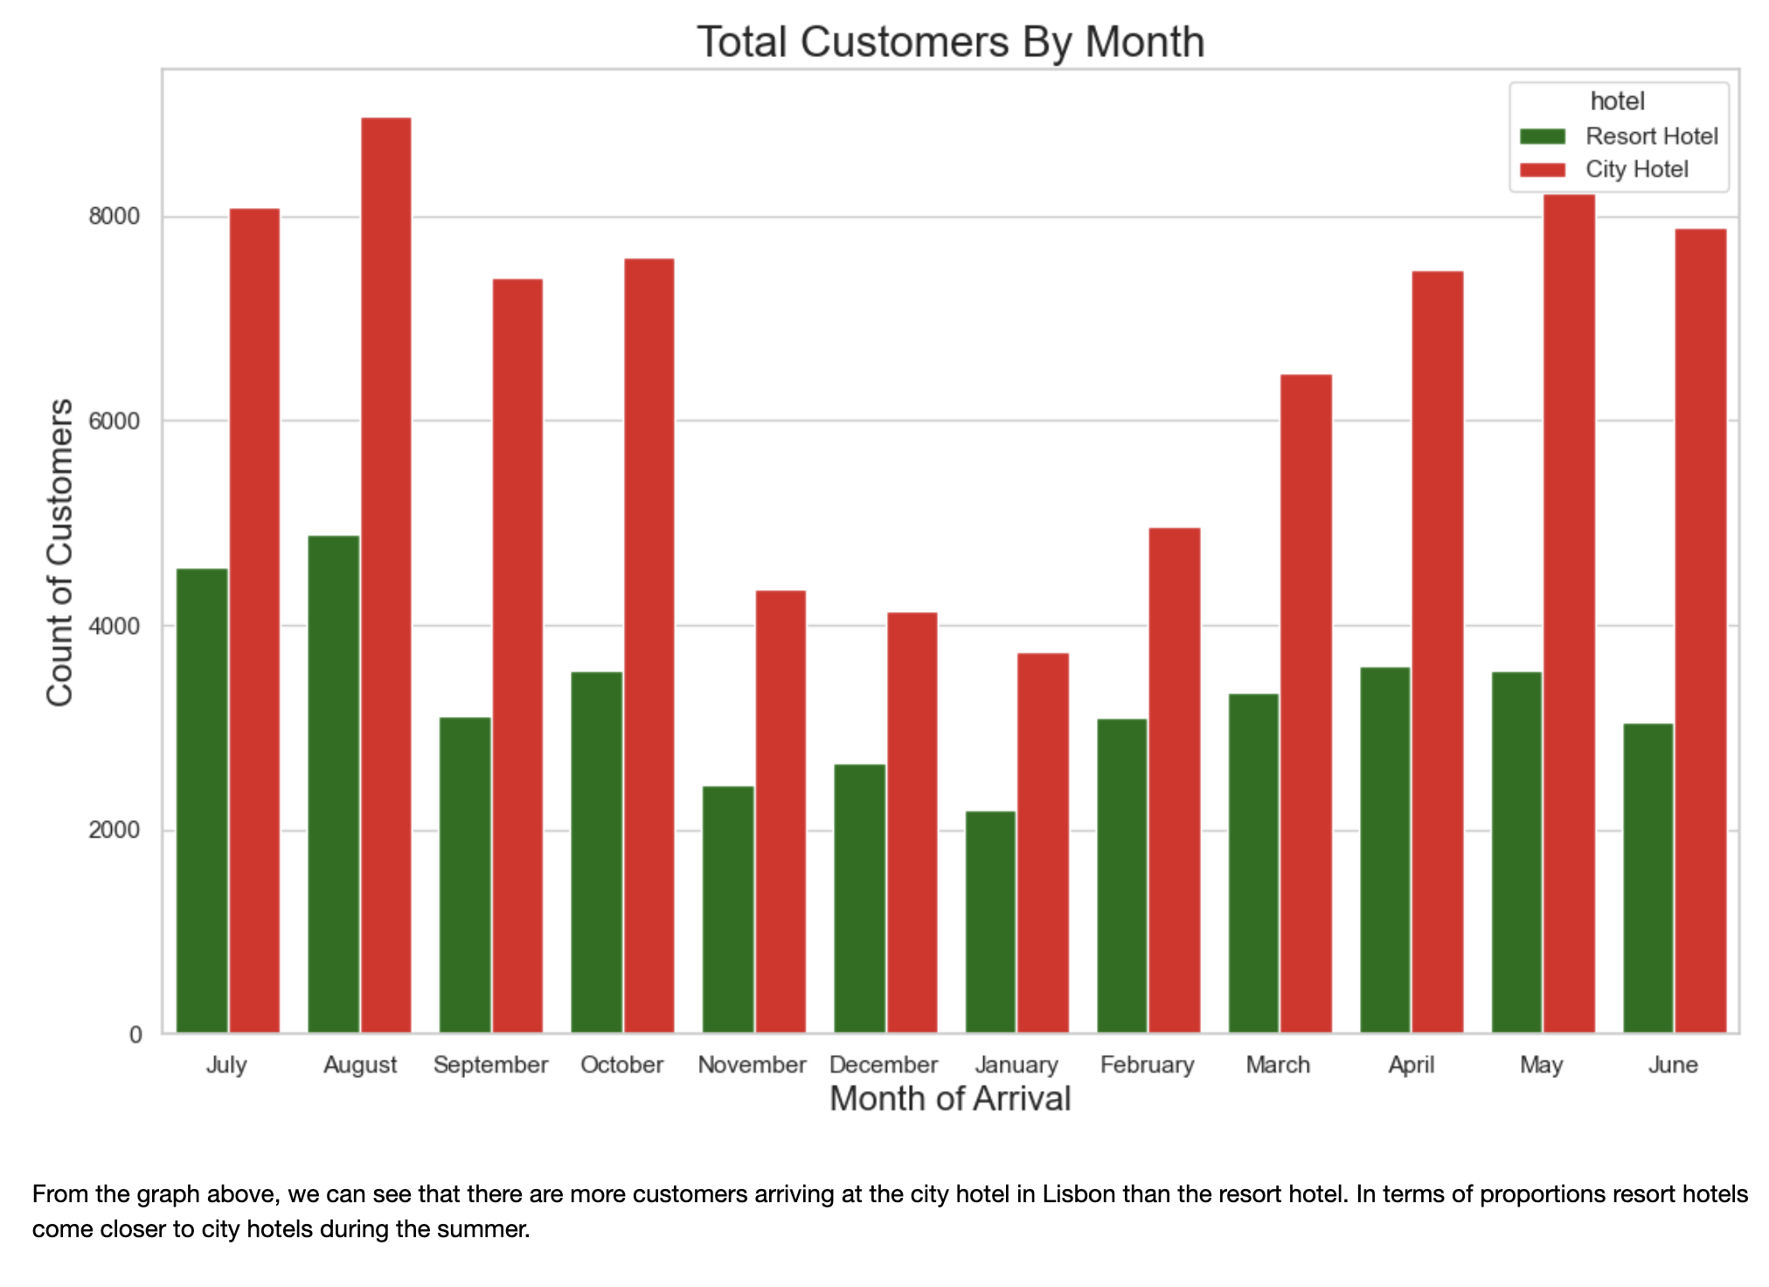
Monthly Arrivals
39
4
29
4
20
35
5
25
22
15
20XX
20XX
20XX

Slide 9
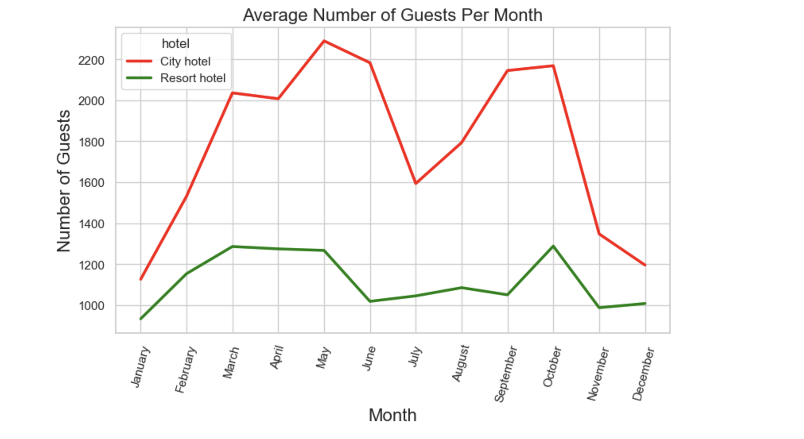
Monthly Average Arrival
Findings
City Hotels - Receive more customers throughout the year, but heavily declines December-February
Resort Hotels - Most customers come during March-May, and October
Peak
Peak
Peak (March-May
Peak

Slide 10
Answer
City Hotel
Reserve July-August and Winter Months
Cheapest and least amount of Customers
Resort Hotel
Any months excluding June-September
The rates are not at its peak and least amount of customers and groups
Deliverable 3
Deliverable 4

